Slide 1
Dash App Presentation
By Kevin Arnold

Slide 2
Introduction
Based a linear regression model that takes a numerical input of the air temperature in degrees Fahrenheit and outputs the predicted number of crime incidents in the Northeast precinct of Omaha, Nebraska.
The model utilizes data tracked and reported daily by the Omaha Police Department.
This Dash app is the front end application that allows a user to implement the model for future predictions

Slide 3
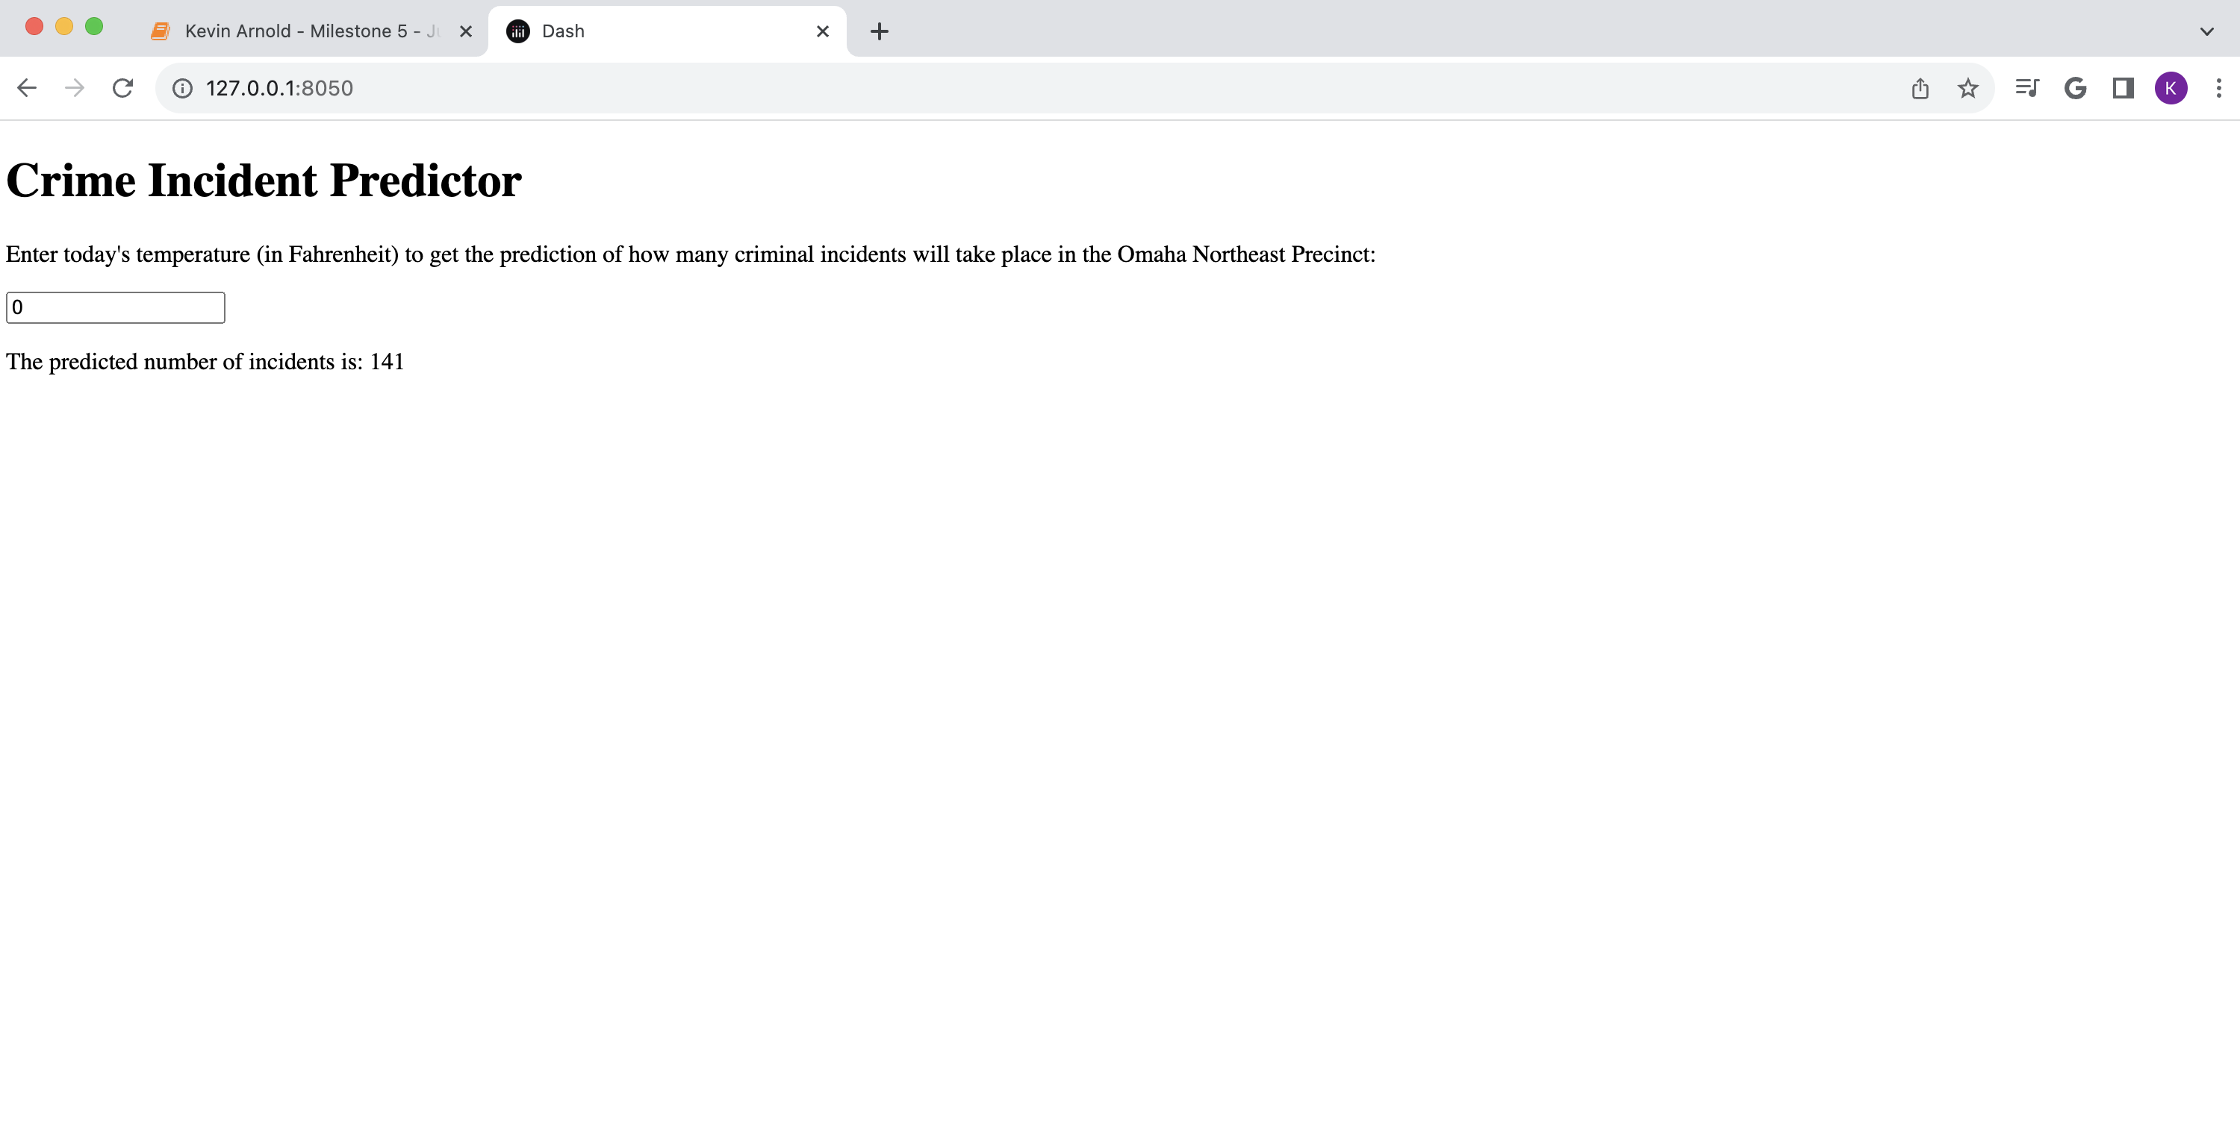
Page upon initializing the app via the ‘Kevin Arnold – Milestone 5.py’ script:

Slide 4
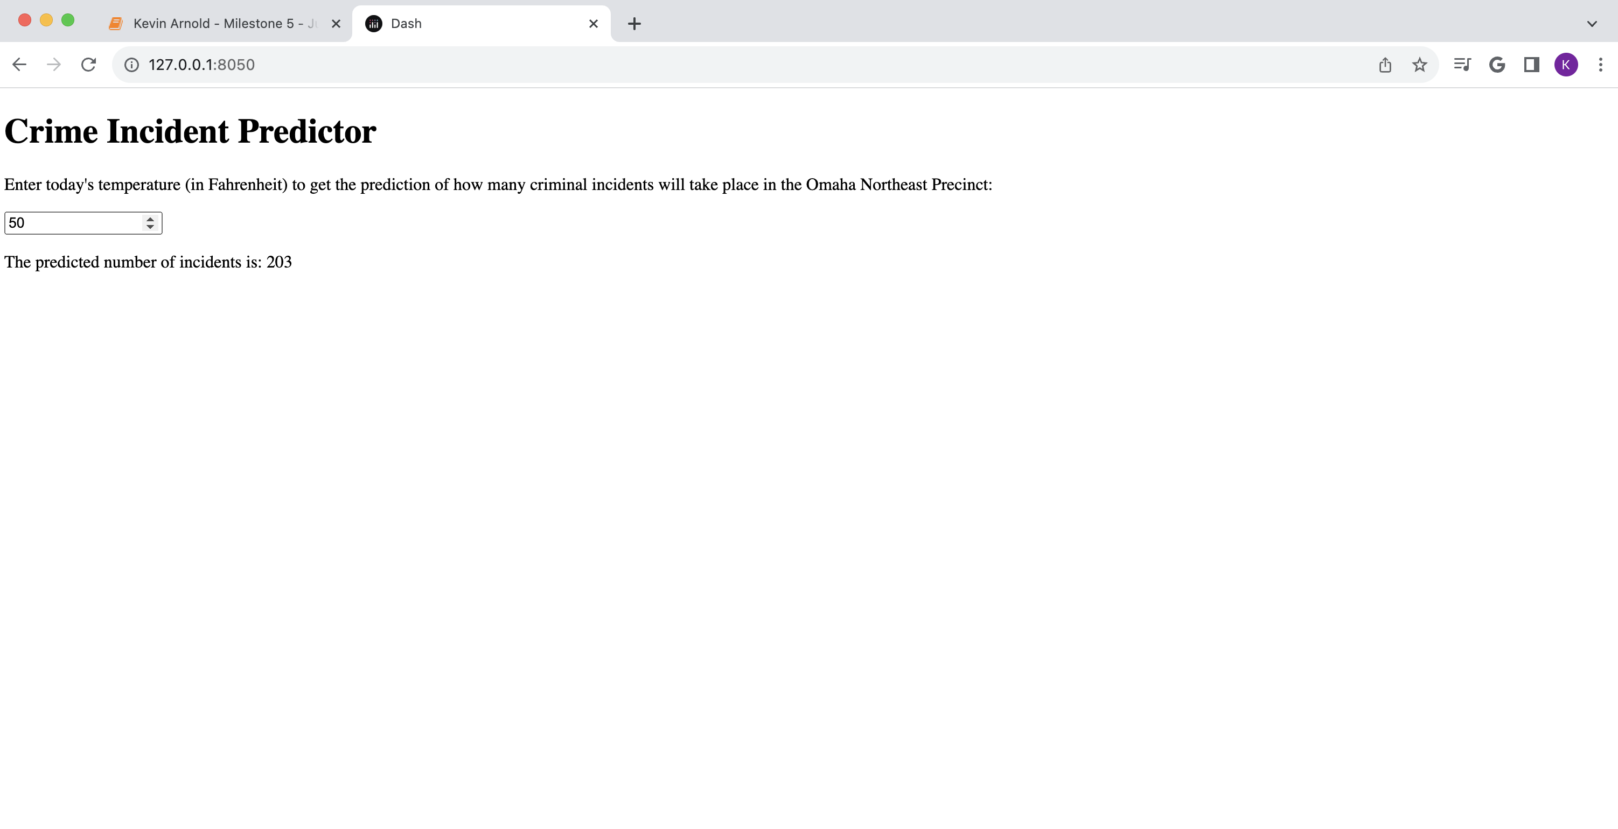
Resulting output after user enters ‘50’ into the text box:

Slide 5
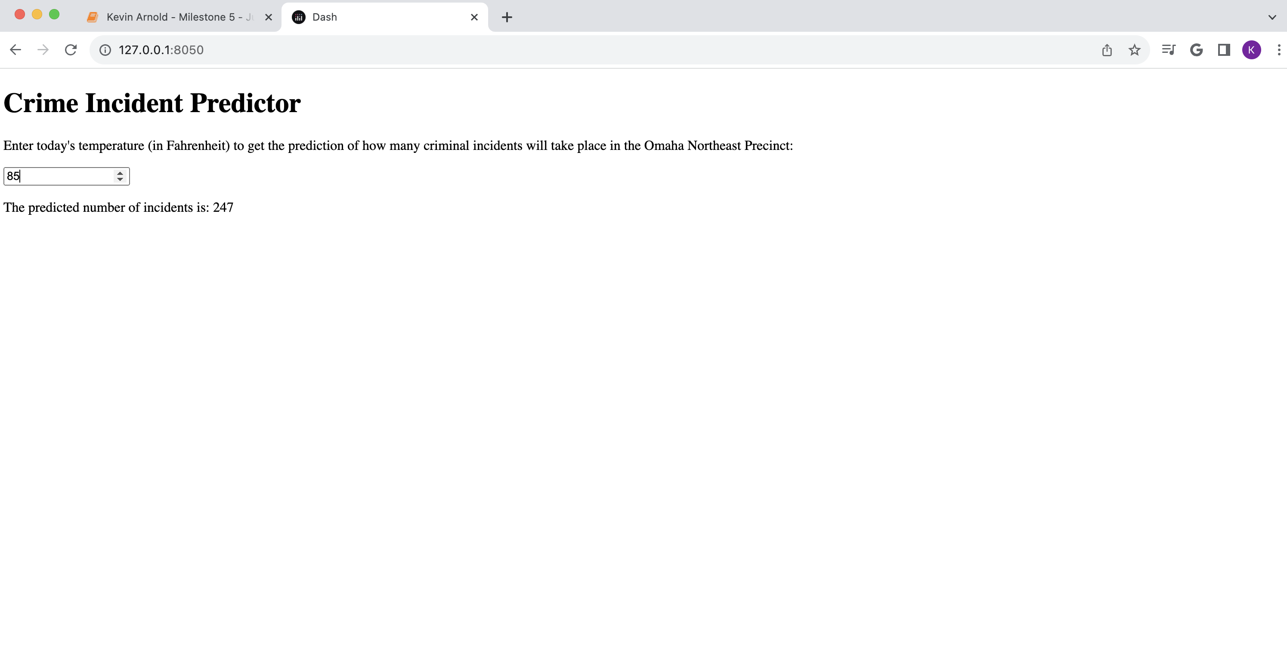
Resulting output after user enters ‘85’ into the text box:

